Slide 1


Bike Rental and Urban Mobility
By Matthew Latondresse

Slide 2
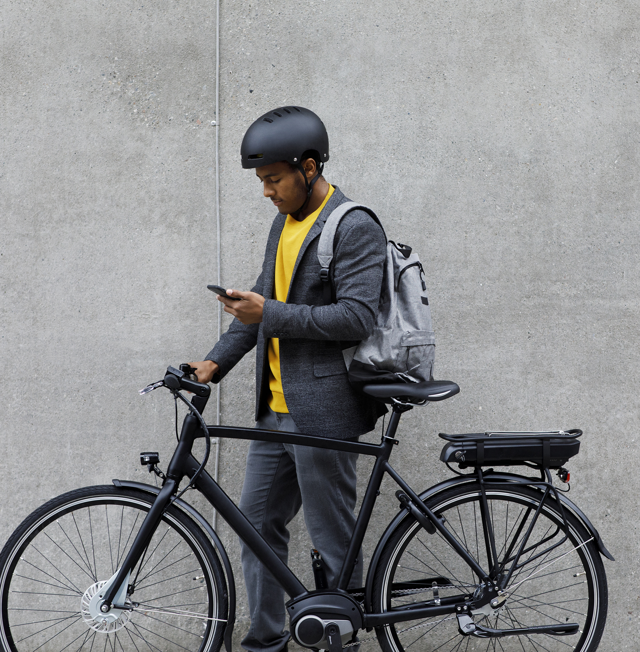
What is Urban Mobility? What are Bike Rental Programs?
Urban Mobility is the examination at how effectively people and goods can get around a city.
Bike rental programs are renting services that allow users to rent a normal or E-bike for an extended period of time.
E-Bikes are electric bikes. They have all the same parts as a normal bike but include an electric motor to reduce fatigue and promote further travel.

Slide 3

Business Problem
Urban Mobility is a growing problem that many large cities face. One of the growing solutions is to this issue is the introduction of rental E-Bike programs.

Slide 4
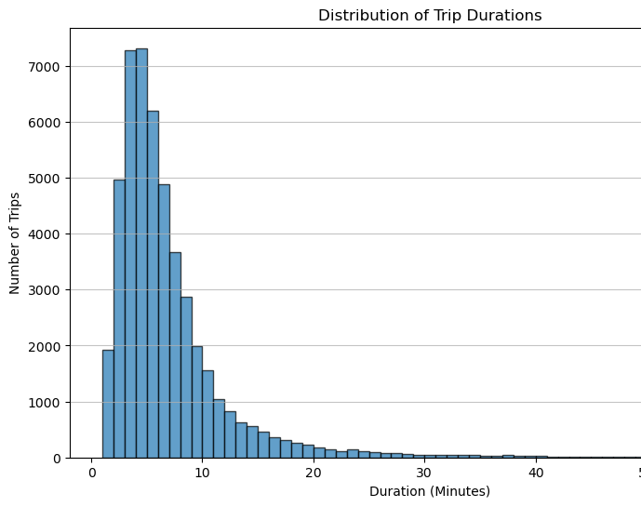
Our Findings So Far
The findings so far have shown several interesting tidbits of information.

Slide 5
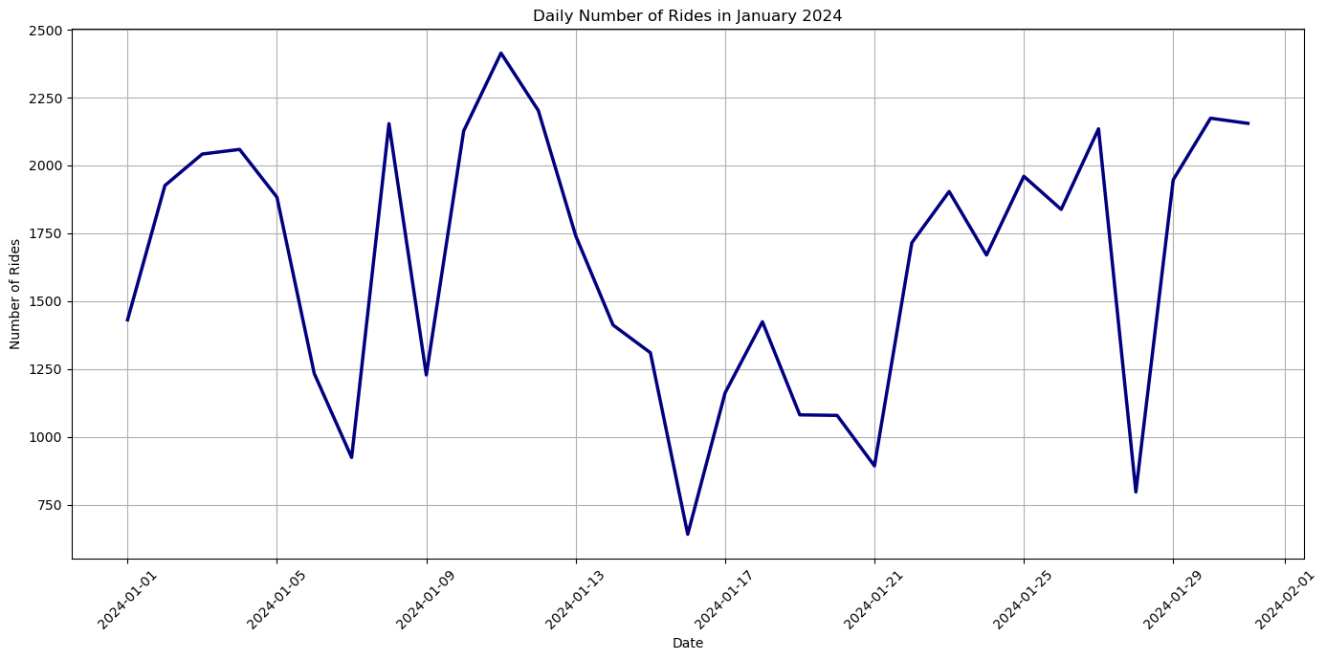
Daily Usage for January

Slide 6

Can the data predict the impact of urban events on mobility?
Yes, by examining the frequency and patterns of bike trips before, during, and after urban events (e.g., concerts, sports events, festivals), one can infer their impact on mobility. An increase in trips starting or ending at locations near event venues could indicate a significant impact. However, precise predictions would require additional data on event schedules and locations.

Slide 7
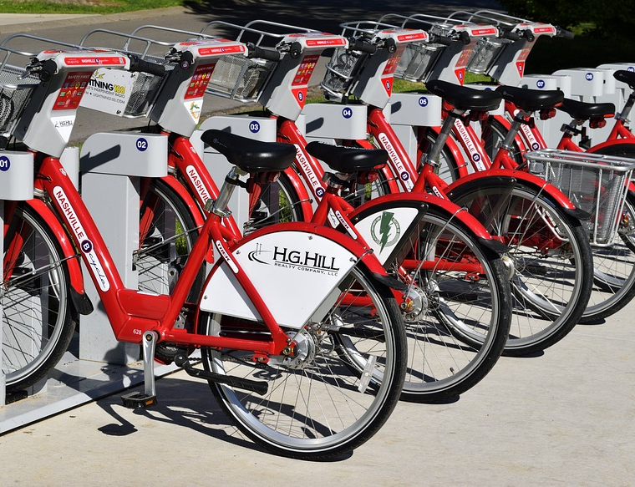
How can cities ensure equitable access to bike-sharing programs?
Cities can promote equitable access by strategically placing bike-sharing stations in underserved areas, offering affordable membership options for low-income residents, and providing alternatives for people without smartphones or credit cards. Accessibility for people with disabilities and multilingual support are also important factors.

Slide 8

Ethical Assessment
The project adheres to ethical guidelines by ensuring user data privacy, addressing potential biases, and safeguarding against unauthorized data access. It seeks to promote equitable and sustainable urban mobility without reinforcing existing inequalities.

